Slide 1
Lecture 2 – Software Processes
Part 1
Source : https://ifs.host.cs.st-andrews.ac.uk/Books/SE9/Presentations/index.html

Slide 2
Topics covered
Software process models
Process activities
Coping with change
The Rational Unified Process
The RUP is a prescriptive, well-defined system development process, often used to develop systems based on object and/or component-based technologies
It is based on sound software engineering principles such as taking an iterative, requirements-driven, and architecture-centric approach to software development
An example of a modern software process.
Notes:
Rational rasyonel akıl sahibi oranlı mantıklı , prescriptive sıkı kurallar koyan kuralcı emreden, sound sapasağlam güvenilir kusursuz doğru

Slide 3
The software process
A structured set of activities required to develop a software system.
Many different software processes but all involve:
Specification – defining what the system should do;
Design and implementation – defining the organization of the system and implementing the system;
Validation – checking that it does what the customer wants;
Evolution – changing the system in response to changing customer needs.
A software process model is an abstract representation of a process. It presents a description of a process from some particular perspective.
Notes:
Abstract soyut özet kuramsal

Slide 4
Software process descriptions
When we describe and discuss processes, we usually talk about the activities in these processes such as specifying a data model, designing a user interface, etc. and the ordering of these activities.
Process descriptions may also include:
Products, which are the outcomes of a process activity;
Roles, which reflect the responsibilities of the people involved in the process;
Pre- and post-conditions, which are statements that are true before and after a process activity has been enacted or a product produced.
Notes:
Enacted oynamak Kabul çıkarmak sahnelemek

Slide 5
Plan-driven and agile processes
Plan-driven processes are processes where all of the process activities are planned in advance and progress is measured against this plan.
In agile processes, planning is incremental and it is easier to change the process to reflect changing customer requirements.
In practice, most practical processes include elements of both plan-driven and agile approaches.
There are no right or wrong software processes.

Slide 6
Software process models
The waterfall model
Plan-driven model. Separate and distinct phases of specification and development.
Incremental development
Specification, development and validation are interleaved. May be plan-driven or agile.
Reuse-oriented software engineering
The system is assembled from existing components. May be plan-driven or agile.
In practice, most large systems are developed using a process that incorporates elements from all of these models.
Notes:
Interleaved iç içe geçmiş

Slide 7
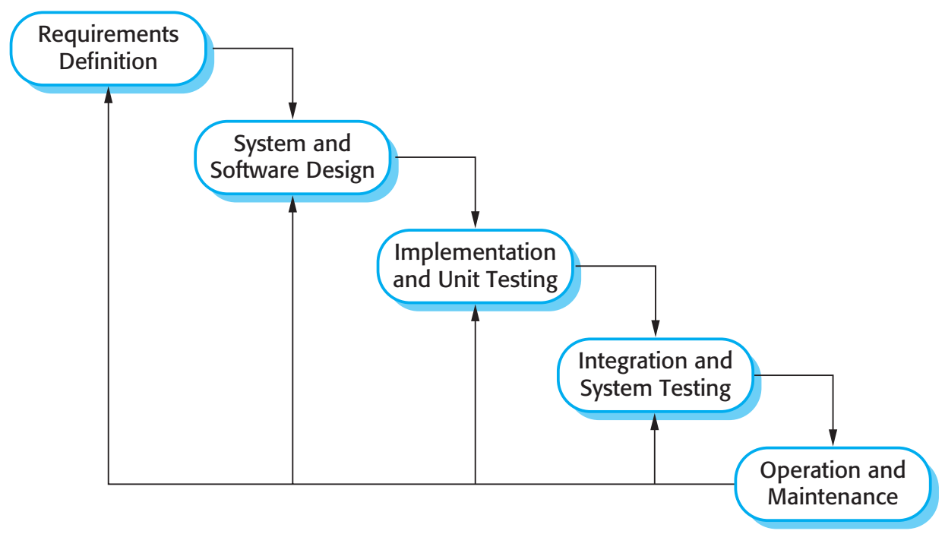
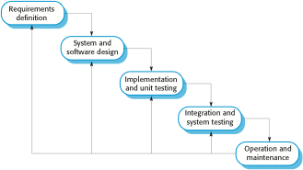
The waterfall model

Slide 8
Waterfall model phases
There are separate identified phases in the waterfall model:
Requirements analysis and definition
System and software design
Implementation and unit testing
Integration and system testing
Operation and maintenance
The main drawback of the waterfall model is the difficulty of accommodating change after the process is underway. In principle, a phase has to be complete before moving onto the next phase.
Notes:
Accommodate yerleştirmek uyum sağlamak uzlaştırmak uydurmak bağdaştırmak

Slide 9
Waterfall model problems
Inflexible partitioning of the project into distinct stages makes it difficult to respond to changing customer requirements.
Therefore, this model is only appropriate when the requirements are well-understood and changes will be fairly limited during the design process.
Few business systems have stable requirements.
The waterfall model is mostly used for large systems engineering projects where a system is developed at several sites.
In those circumstances, the plan-driven nature of the waterfall model helps coordinate the work.

Slide 10
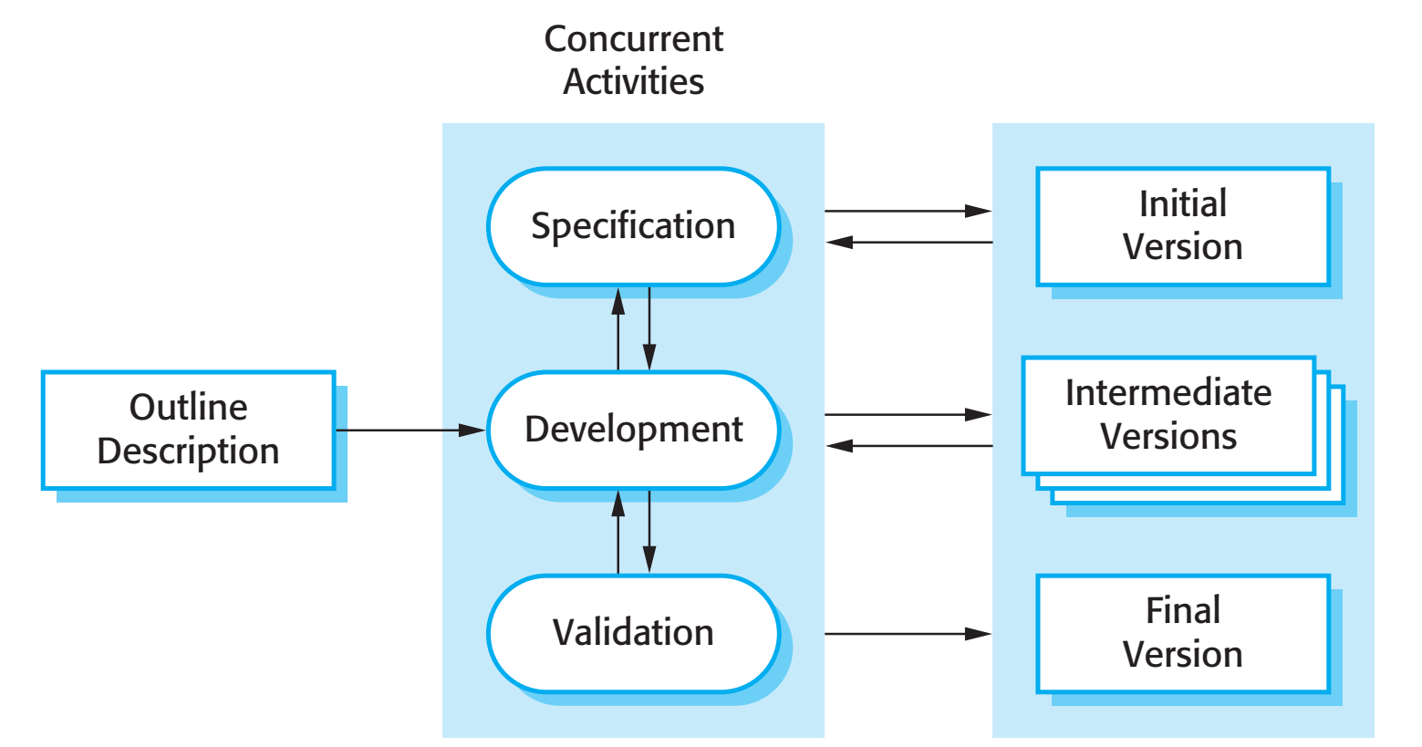
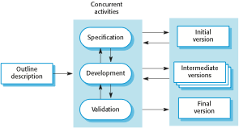
Incremental development

Slide 11
Incremental development benefits
The cost of accommodating changing customer requirements is reduced.
The amount of analysis and documentation that has to be redone is much less than is required with the waterfall model.
It is easier to get customer feedback on the development work that has been done.
Customers can comment on demonstrations of the software and see how much has been implemented.
More rapid delivery and deployment of useful software to the customer is possible.
Customers are able to use and gain value from the software earlier than is possible with a waterfall process.

Slide 12
Incremental development problems
The process is not visible.
Managers need regular deliverables to measure progress. If systems are developed quickly, it is not cost-effective to produce documents that reflect every version of the system.
System structure tends to degrade as new increments are added.
Unless time and money is spent on refactoring to improve the software, regular change tends to corrupt its structure. Incorporating further software changes becomes increasingly difficult and costly.

Slide 13
Reuse-oriented software engineering
Based on systematic reuse where systems are integrated from existing components or COTS (Commercial-off-the-shelf) systems.
Process stages
Component analysis;
Requirements modification;
System design with reuse;
Development and integration.
Reuse is now the standard approach for building many types of business system
Reuse covered in more depth in Chapter 16.

Slide 14
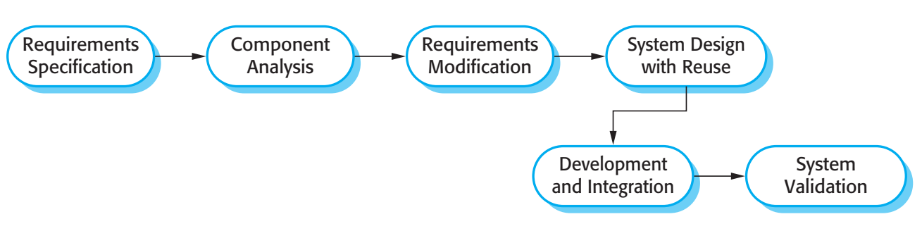

Reuse-oriented software engineering

Slide 15
Types of software component
Web services that are developed according to service standards and which are available for remote invocation.
Collections of objects that are developed as a package to be integrated with a component framework such as .NET or J2EE.
Stand-alone software systems (COTS) that are configured for use in a particular environment.
Notes:
Invocation yürütme başlatma yalvarma yakarma

Slide 16
Process activities
Real software processes are inter-leaved sequences of technical, collaborative and managerial activities with the overall goal of specifying, designing, implementing and testing a software system.
The four basic process activities of specification, development, validation and evolution are organized differently in different development processes. In the waterfall model, they are organized in sequence, whereas in incremental development they are inter-leaved.

Slide 17
Software specification
The process of establishing what services are required and the constraints on the system’s operation and development.
Requirements engineering process
Feasibility study
Is it technically and financially feasible to build the system?
Requirements elicitation and analysis
What do the system stakeholders require or expect from the system?
Requirements specification
Defining the requirements in detail
Requirements validation
Checking the validity of the requirements

Slide 18
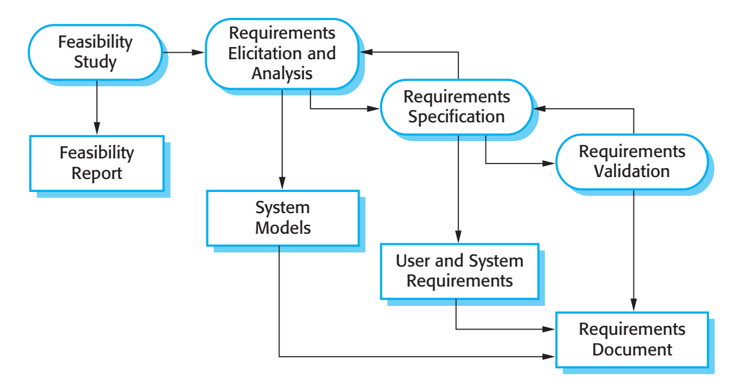
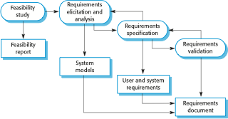
The requirements engineering process

Slide 19
Software design and implementation
The process of converting the system specification into an executable system.
Software design
Design a software structure that realises the specification;
Implementation
Translate this structure into an executable program;
The activities of design and implementation are closely related and may be inter-leaved.

Slide 20
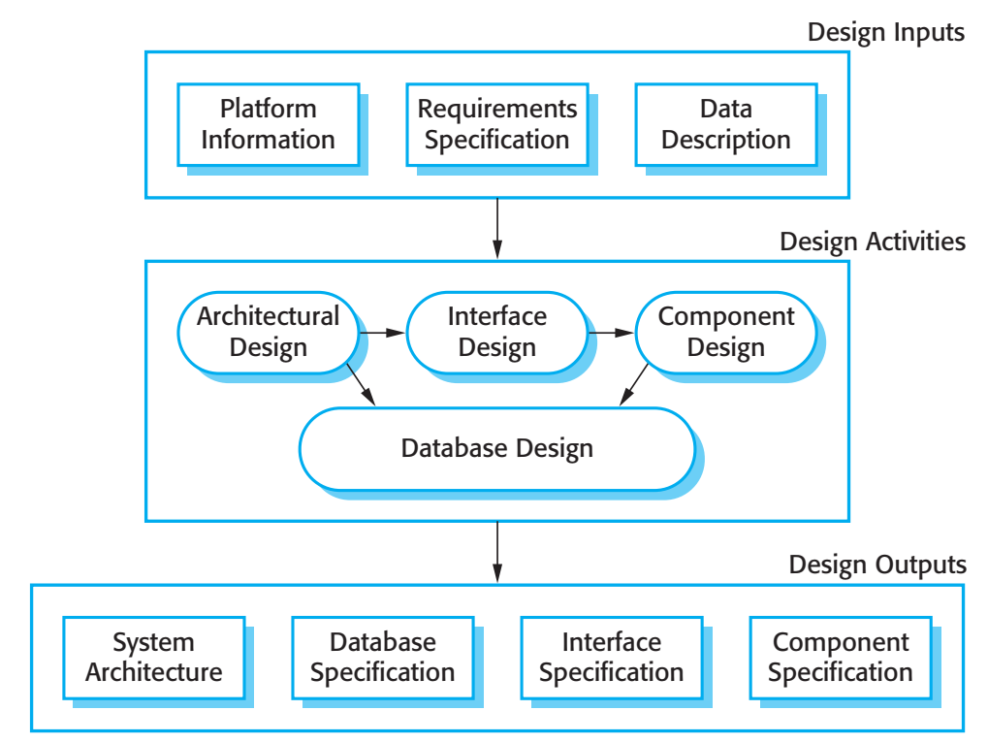
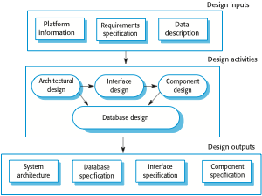
A general model of the design process

Slide 21
Design activities
Architectural design, where you identify the overall structure of the system, the principal components (sometimes called sub-systems or modules), their relationships and how they are distributed.
Interface design, where you define the interfaces between system components.
Component design, where you take each system component and design how it will operate.
Database design, where you design the system data structures and how these are to be represented in a database.

Slide 22
Software validation
Verification and validation (V & V) is intended to show that a system conforms to its specification and meets the requirements of the system customer.
Involves checking and review processes and system testing.
System testing involves executing the system with test cases that are derived from the specification of the real data to be processed by the system.
Testing is the most commonly used V & V activity.

Slide 23
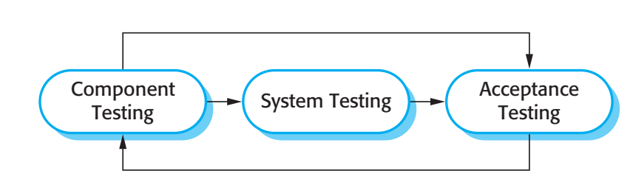

Stages of testing

Slide 24
Testing stages
Development or component testing
Individual components are tested independently;
Components may be functions or objects or coherent groupings of these entities.
System testing
Testing of the system as a whole. Testing of emergent properties is particularly important.
Acceptance testing
Testing with customer data to check that the system meets the customer’s needs.

Slide 25
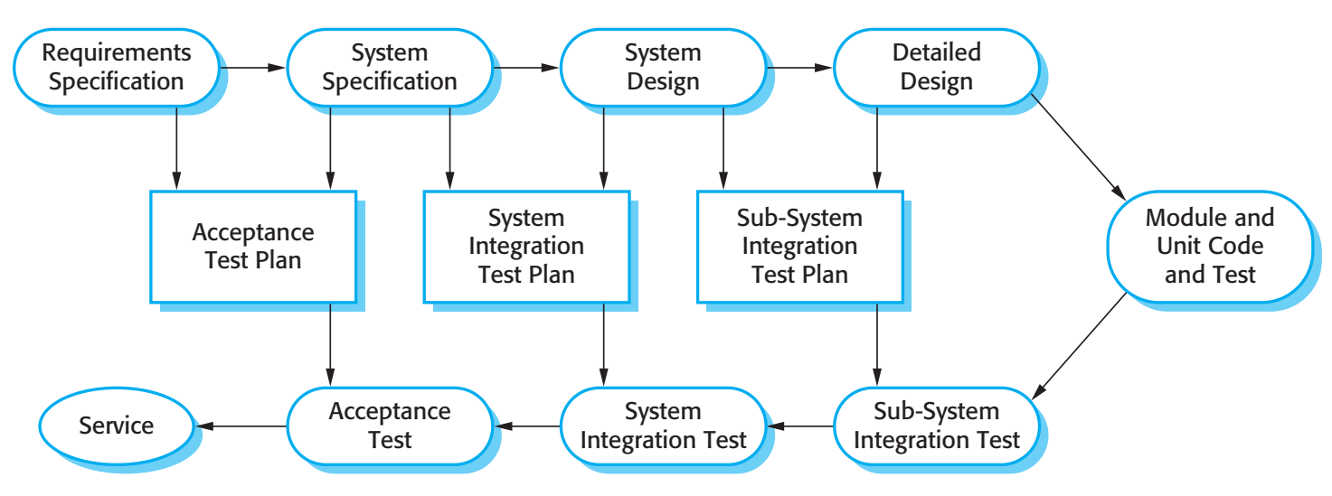
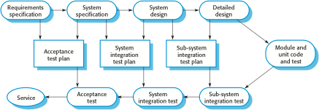
Testing phases in a plan-driven software process

Slide 26
Software evolution
Software is inherently flexible and can change.
As requirements change through changing business circumstances, the software that supports the business must also evolve and change.
Although there has been a demarcation between development and evolution (maintenance) this is increasingly irrelevant as fewer and fewer systems are completely new.

Slide 27
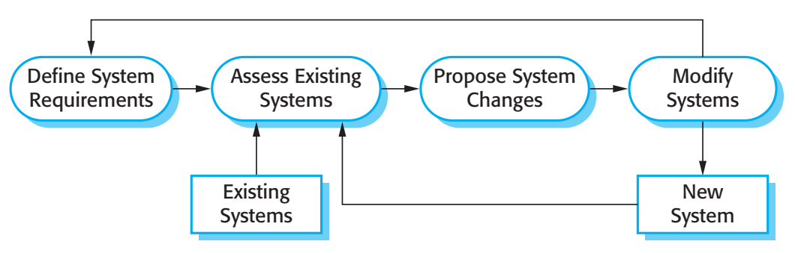

System evolution

Slide 28
Key points
Software processes are the activities involved in producing a software system. Software process models are abstract representations of these processes.
General process models describe the organization of software processes. Examples of these general models include the ‘waterfall’ model, incremental development, and reuse-oriented development.

Slide 29
Key points
Requirements engineering is the process of developing a software specification.
Design and implementation processes are concerned with transforming a requirements specification into an executable software system.
Software validation is the process of checking that the system conforms to its specification and that it meets the real needs of the users of the system.
Software evolution takes place when you change existing software systems to meet new requirements. The software must evolve to remain useful.

Slide 30
Lecture 2 – Software Processes
Part 2

Slide 31
Coping with change
Change is inevitable in all large software projects.
Business changes lead to new and changed system requirements
New technologies open up new possibilities for improving implementations
Changing platforms require application changes
Change leads to rework so the costs of change include both rework (e.g. re-analysing requirements) as well as the costs of implementing new functionality

Slide 32
Reducing the costs of rework
Change avoidance, where the software process includes activities that can anticipate possible changes before significant rework is required.
For example, a prototype system may be developed to show some key features of the system to customers.
Change tolerance, where the process is designed so that changes can be accommodated at relatively low cost.
This normally involves some form of incremental development. Proposed changes may be implemented in increments that have not yet been developed. If this is impossible, then only a single increment (a small part of the system) may have be altered to incorporate the change.

Slide 33
Software prototyping
A prototype is an initial version of a system used to demonstrate concepts and try out design options.
A prototype can be used in:
The requirements engineering process to help with requirements elicitation and validation;
In design processes to explore options and develop a UI design;
In the testing process to run back-to-back tests.

Slide 34
Benefits of prototyping
Improved system usability.
A closer match to users’ real needs.
Improved design quality.
Improved maintainability.
Reduced development effort.

Slide 35
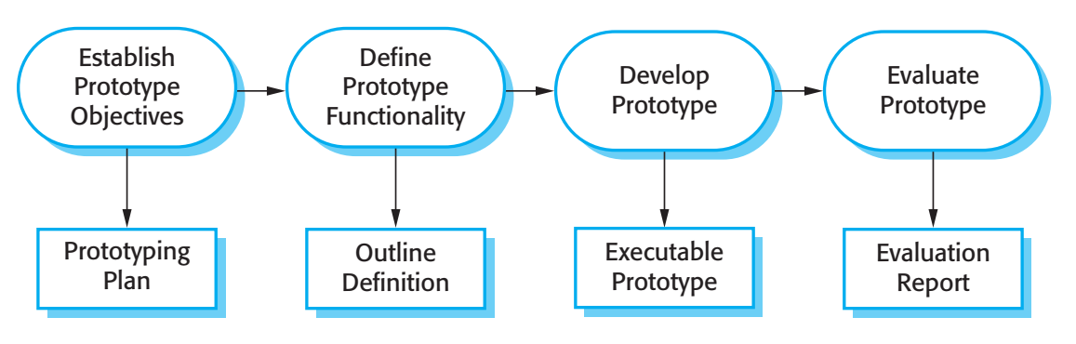

The process of prototype development

Slide 36
Prototype development
May be based on rapid prototyping languages or tools
May involve leaving out functionality
Prototype should focus on areas of the product that are not well-understood;
Error checking and recovery may not be included in the prototype;
Focus on functional rather than non-functional requirements such as reliability and security

Slide 37
Throw-away prototypes
Prototypes should be discarded after development as they are not a good basis for a production system:
It may be impossible to tune the system to meet non-functional requirements;
Prototypes are normally undocumented;
The prototype structure is usually degraded through rapid change;
The prototype probably will not meet normal organisational quality standards.

Slide 38
Incremental delivery
Rather than deliver the system as a single delivery, the development and delivery is broken down into increments with each increment delivering part of the required functionality.
User requirements are prioritised and the highest priority requirements are included in early increments.
Once the development of an increment is started, the requirements are frozen though requirements for later increments can continue to evolve.

Slide 39
Incremental development and delivery
Incremental development
Develop the system in increments and evaluate each increment before proceeding to the development of the next increment;
Normal approach used in agile methods;
Evaluation done by user/customer proxy.
Incremental delivery
Deploy an increment for use by end-users;
More realistic evaluation about practical use of software;
Difficult to implement for replacement systems as increments have less functionality than the system being replaced.

Slide 40
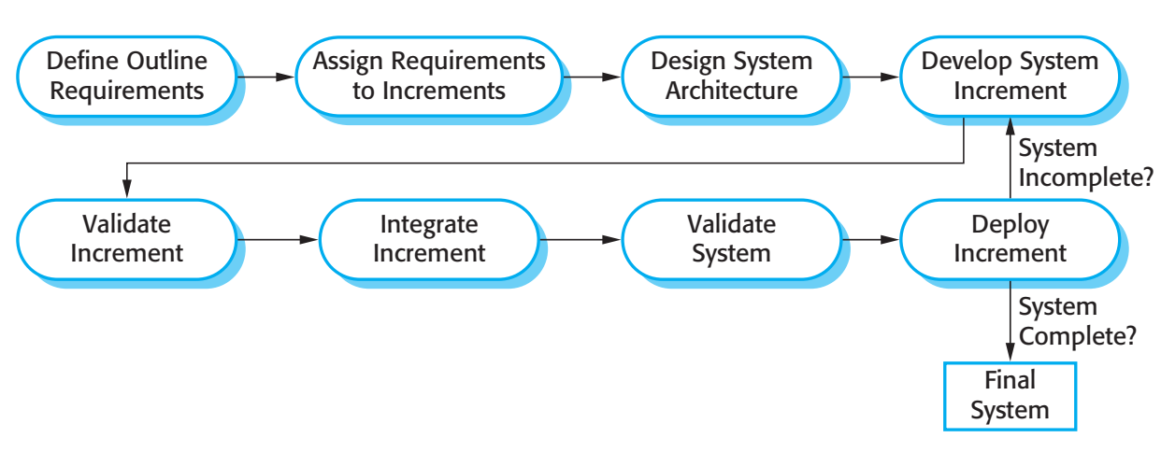
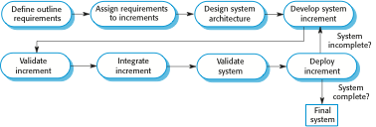
Incremental delivery

Slide 41
Incremental delivery advantages
Customer value can be delivered with each increment so system functionality is available earlier.
Early increments act as a prototype to help elicit requirements for later increments.
Lower risk of overall project failure.
The highest priority system services tend to receive the most testing.

Slide 42
Incremental delivery problems
Most systems require a set of basic facilities that are used by different parts of the system.
As requirements are not defined in detail until an increment is to be implemented, it can be hard to identify common facilities that are needed by all increments.
The essence of iterative processes is that the specification is developed in conjunction with the software.
However, this conflicts with the procurement model of many organizations, where the complete system specification is part of the system development contract.

Slide 43
Boehm’s spiral model
Process is represented as a spiral rather than as a sequence of activities with backtracking.
Each loop in the spiral represents a phase in the process.
No fixed phases such as specification or design - loops in the spiral are chosen depending on what is required.
Risks are explicitly assessed and resolved throughout the process.

Slide 44
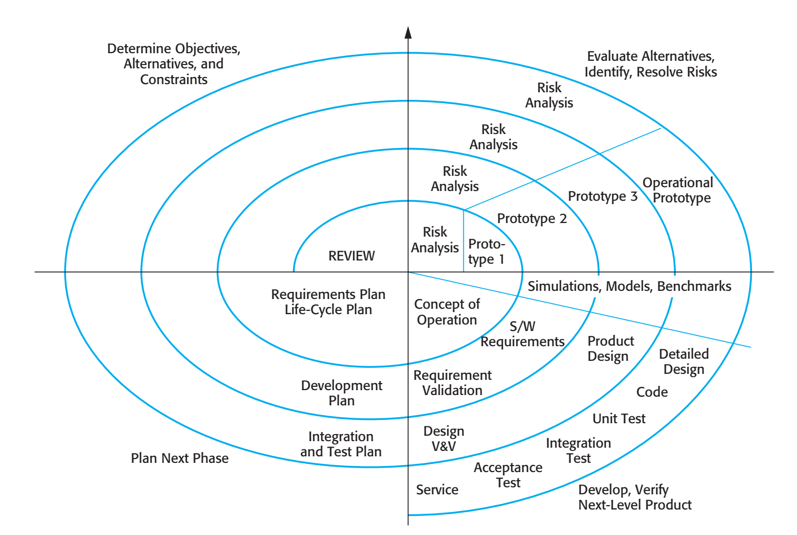
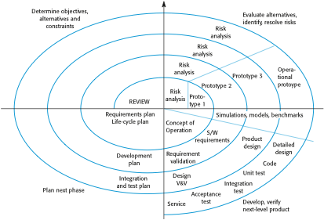
Boehm’s spiral model of the software process

Slide 45
Spiral model sectors
Objective setting
Specific objectives for the phase are identified.
Risk assessment and reduction
Risks are assessed and activities put in place to reduce the key risks.
Development and validation
A development model for the system is chosen which can be any of the generic models.
Planning
The project is reviewed and the next phase of the spiral is planned.

Slide 46
Spiral model usage
Spiral model has been very influential in helping people think about iteration in software processes and introducing the risk-driven approach to development.
In practice, however, the model is rarely used as published for practical software development.

Slide 47
The Rational Unified Process
A modern generic process derived from the work on the UML and associated process.
Brings together aspects of the 3 generic process models discussed previously.
Normally described from 3 perspectives
A dynamic perspective that shows phases over time;
A static perspective that shows process activities;
A practive perspective that suggests good practice.

Slide 48
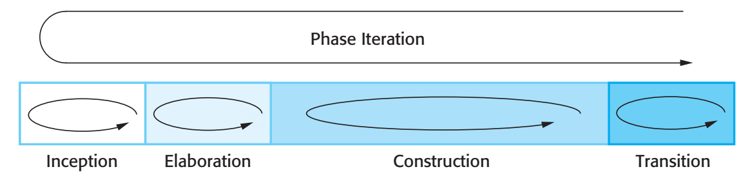

Phases in the Rational Unified Process

Slide 49
RUP phases
Inception
Establish the business case for the system.
Elaboration
Develop an understanding of the problem domain and the system architecture.
Construction
System design, programming and testing.
Transition
Deploy the system in its operating environment.

Slide 50
RUP iteration
In-phase iteration
Each phase is iterative with results developed incrementally.
Cross-phase iteration
As shown by the loop in the RUP model, the whole set of phases may be enacted incrementally.

Slide 51
Static workflows in the Rational Unified Process
Workflow | Description
Business modelling | The business processes are modelled using business use cases.
Requirements | Actors who interact with the system are identified and use cases are developed to model the system requirements.
Analysis and design | A design model is created and documented using architectural models, component models, object models and sequence models.
Implementation | The components in the system are implemented and structured into implementation sub-systems. Automatic code generation from design models helps accelerate this process.

Slide 52
Static workflows in the Rational Unified Process
Workflow | Description
Testing | Testing is an iterative process that is carried out in conjunction with implementation. System testing follows the completion of the implementation.
Deployment | A product release is created, distributed to users and installed in their workplace.
Configuration and change management | This supporting workflow managed changes to the system (see Lecture 25).
Project management | This supporting workflow manages the system development (see Chapters 22 and 23).
Environment | This workflow is concerned with making appropriate software tools available to the software development team.

Slide 53
RUP good practice
Develop software iteratively
Plan increments based on customer priorities and deliver highest priority increments first.
Manage requirements
Explicitly document customer requirements and keep track of changes to these requirements.
Use component-based architectures
Organize the system architecture as a set of reusable components.

Slide 54
RUP good practice
Visually model software
Use graphical UML models to present static and dynamic views of the software.
Verify software quality
Ensure that the software meet’s organizational quality standards.
Control changes to software
Manage software changes using a change management system and configuration management tools.

Slide 55
Key points
Processes should include activities to cope with change. This may involve a prototyping phase that helps avoid poor decisions on requirements and design.
Processes may be structured for iterative development and delivery so that changes may be made without disrupting the system as a whole.
The Rational Unified Process is a modern generic process model that is organized into phases (inception, elaboration, construction and transition) but separates activities (requirements, analysis and design, etc.) from these phases.

